Slide 1




Trivia
AM Hours
Name Placeholder
4
5
6
7
8
9
10
12
11
Date and Time Placeholder
1
2
3
Today
PM Hours
0
0
Wake Count
Screen-On Time
4
5
6
7
8
9
10
12
11
1
2
3
Name Placeholder
Record for the last 6 days
Date and Time Placeholder
Wake Count
Screen Time
Previous Stats
0
0
Yesterday
Your Device Real-time Screen Activity
0
0
Placeholder
0
0
Screen Wake Count
Screen Time by Hours
Placeholder
00
00
0
0
Placeholder
0
0
Screen-time Status
Placeholder
0
0
Placeholder

Slide 2




Trivia
Trivia
Name Placeholder
Settings
Date and Time Placeholder
Today
0
0
Display Profile
Wake Count
Screen-On Time
Username
Name Placeholder
Name Placeholder
Record for the last 6 days
Dark mode
Date and Time Placeholder
Wake Count
Screen Time
Date and Time Placeholder
Previous Stats
0
0
About app
Previous Stats
Yesterday
Your Device Real-time Screen Activity
0
0
Your Device Real-time Screen Activity
Placeholder
0
0
Screen Wake Count
Screen Time by Hours
Screen Wake Count
Screen Time by Hours
Placeholder
00
00
0
0
00
00
Placeholder
0
0
Screen-time Status
Placeholder
Screen-time Status
0
0
Placeholder

Slide 3
Trivia
Trivia
Name Placeholder
Settings
Date and Time Placeholder
Today
0
0
Display Profile
Wake Count
Screen-On Time
Display Profile
Name Placeholder
Name Placeholder
Record for the last 6 days
Dark mode
Date and Time Placeholder
Wake Count
Screen Time
Date and Time Placeholder
Previous Stats
0
0
About app
Previous Stats
Yesterday
Your Device Real-time Screen Activity
0
0
Your Device Real-time Screen Activity
Placeholder
0
0
Screen Wake Count
Screen Time by Hours
Screen Wake Count
Screen Time by Hours
Placeholder
00
00
0
0
00
00
Placeholder
0
0
Screen-time Status
Placeholder
Screen-time Status
0
0
Placeholder

Slide 4
Trivia
Trivia
Name Placeholder
Date and Time Placeholder
Today
0
0
Wake Count
Screen-On Time
Name Placeholder
Name Placeholder
Record for the last 6 days
Date and Time Placeholder
Wake Count
Screen Time
Date and Time Placeholder
Previous Stats
0
0
Previous Stats
Yesterday
Your Device Real-time Screen Activity
0
0
Your Device Real-time Screen Activity
Placeholder
0
0
Screen Wake Count
Screen Time by Hours
Screen Wake Count
Screen Time by Hours
Placeholder
00
00
0
0
00
00
Placeholder
0
0
Screen-time Status
Placeholder
Screen-time Status
0
0

Slide 5
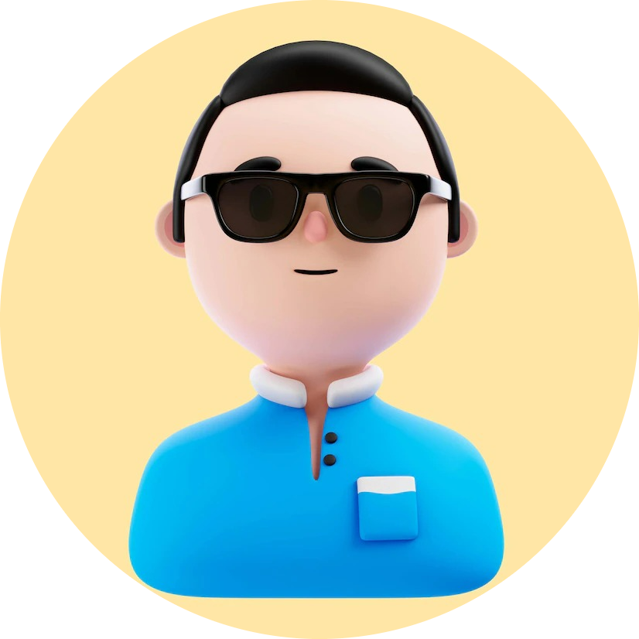



Trivia
Name Placeholder
Date and Time Placeholder
Previous Stats
Your Device Real-time Screen Activity
Screen Wake Count
Screen Time by Hours
00
00
Screen-time Status

Slide 6



Protect
Relax
Monitor
Bring awareness to your screen
Self Care through meditation
Track distractions and stay focus

Slide 7


Name Placeholder
Date and Time Placeholder
Today
0
0
Wake Count
Screen-On Time
Record for the last 6 days
Wake Count
Screen Time
0
0
Yesterday
0
0
Placeholder
0
0
Placeholder
0
0
Placeholder
0
0
Placeholder
0
0
Placeholder

Slide 8








